Slide 1
Day 4/100 Java Practice
100 Days of Coding Practice
Navaneethan

Slide 2
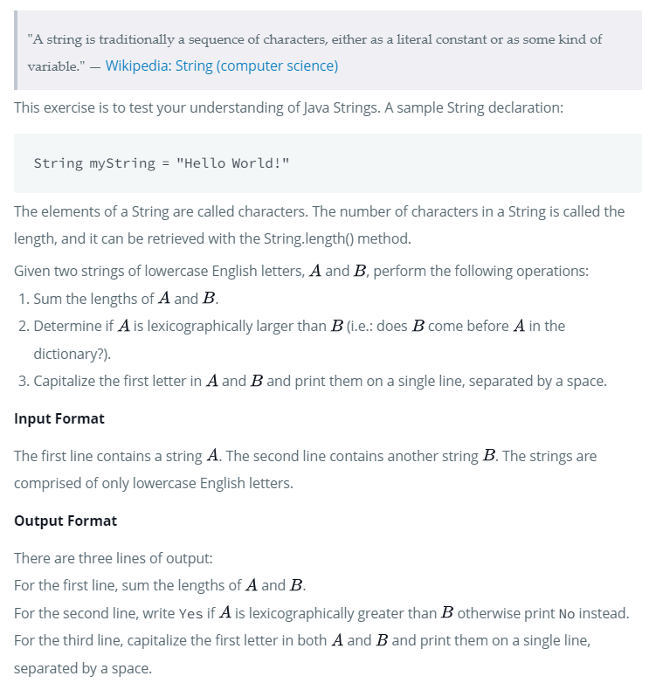
Prg – 1: Java Strings

Slide 3
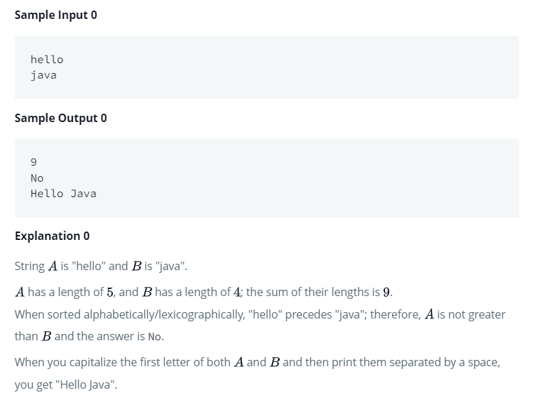
Prg – 1: Java Strings

Slide 4
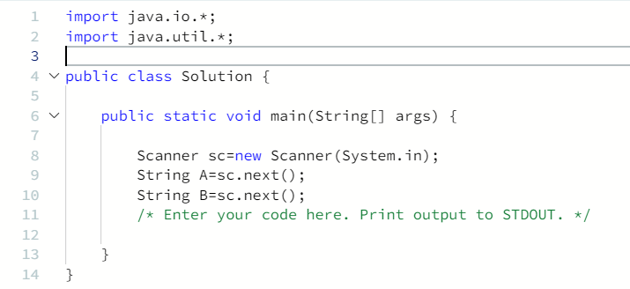
Prg – 1: Java Strings – CODE SNIPPET

Slide 5
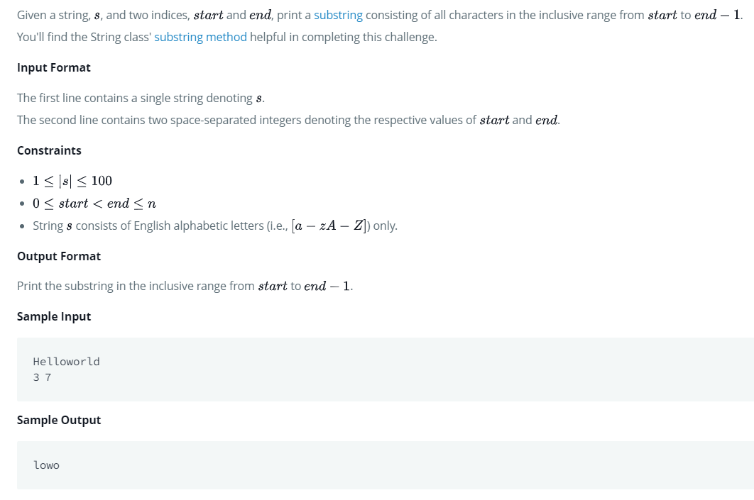
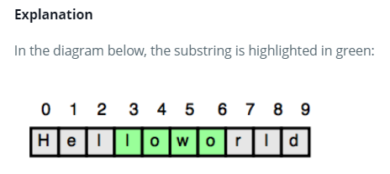
Prg – 2: Java substring

Slide 6
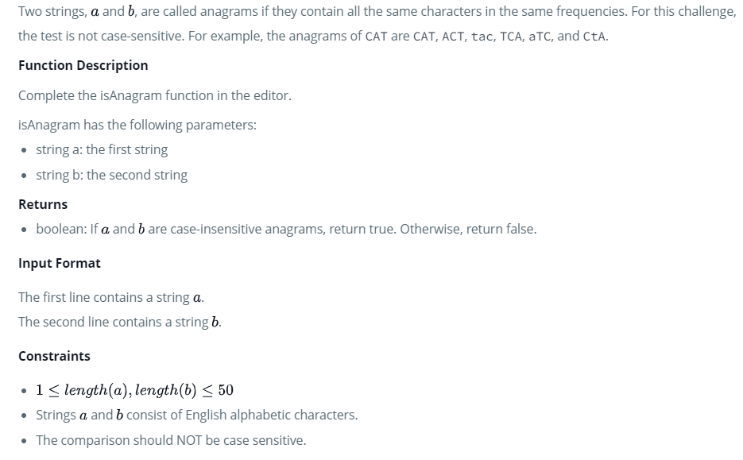
Prg – 3: Java ANAGRAMS

Slide 7
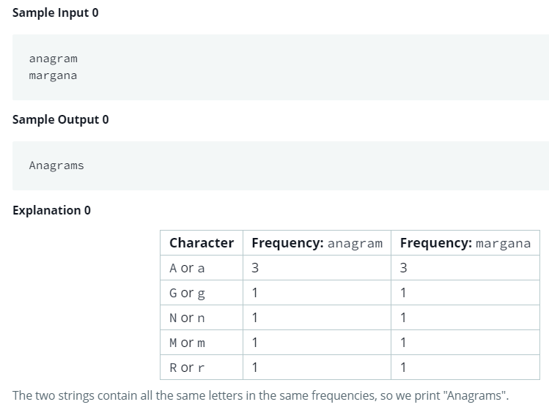
Prg – 3: Java ANAGRAMS

Slide 8
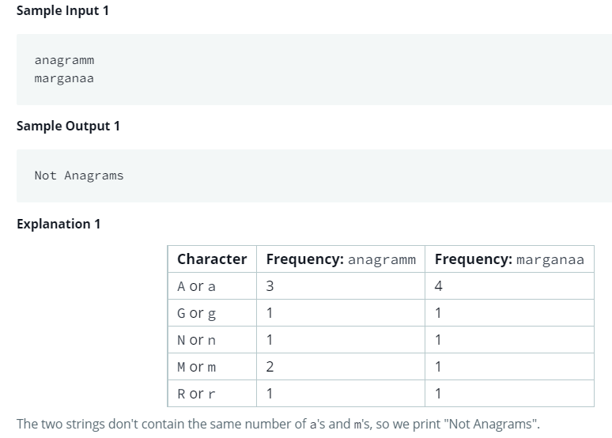
Prg – 3: Java ANAGRAMS

Slide 9
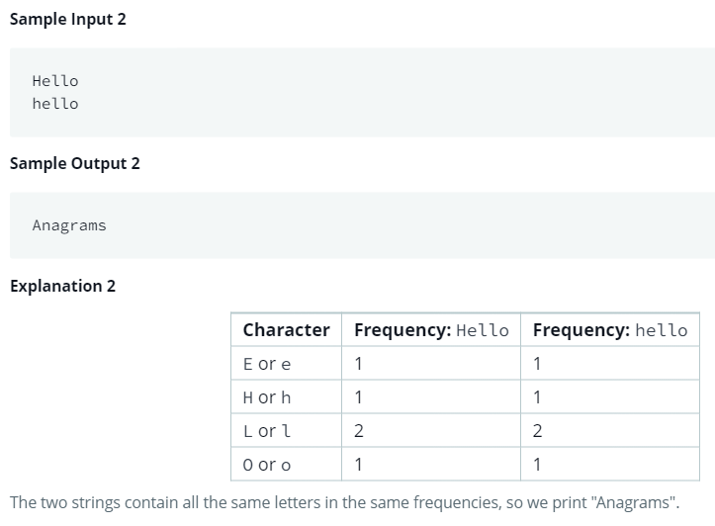
Prg – 3: Java ANAGRAMS

Slide 10
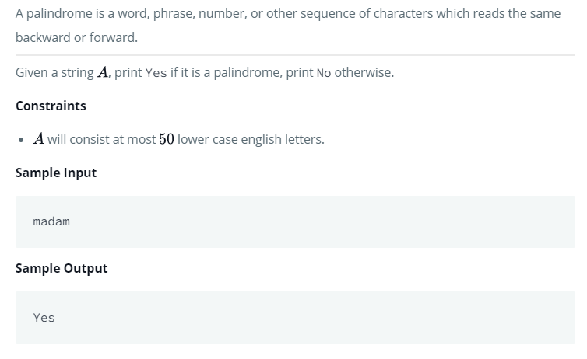
Prg – 4: Java string reverse

Slide 11
Prg – 5: Java PRIME NUMBER
Write a java Program to check whether the given input number is a Prime Number or Not a Prime Number.
A prime number is a number that is divisible by only two numbers: 1 and itself. So, if any number is divisible by any other number, it is not a prime number.
Sample Input 0 : 29
Sample Output 0 : 29 is a prime number.
Sample Input 1 : 33
Sample Output 1 : 33 is NOT a prime number.

